Slide 1
Security & Microservices
How to do it with Spring Boot and Keycloak
Vienna, January 23rd 2020 Herwig Steininger

Slide 2
Preview
What to expect today
Onfarming
From a user‘s perspective
Looking inside
Authentication & Authorization
OpenID Connect & JWT
Keycloak
Coding examples
Approach #1 (How we did it)
Approach #2 (How we could have done it)

Slide 3
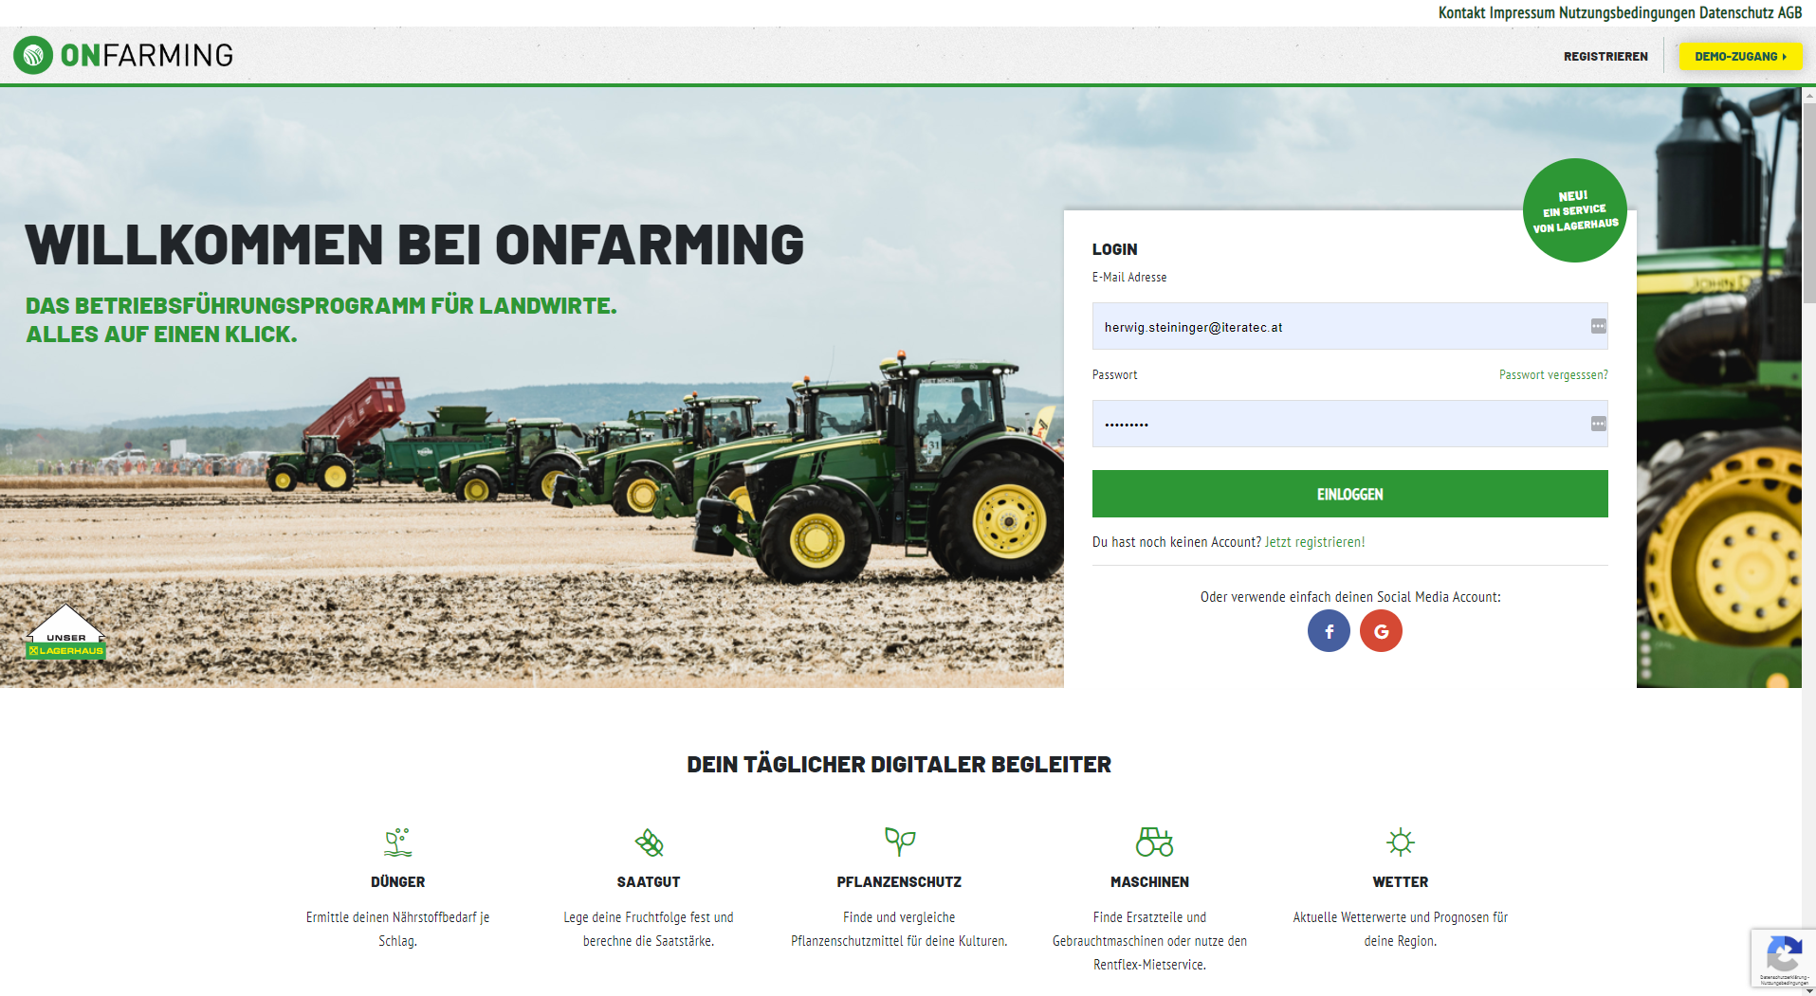
Security in Onfarming
View: Login

Slide 4
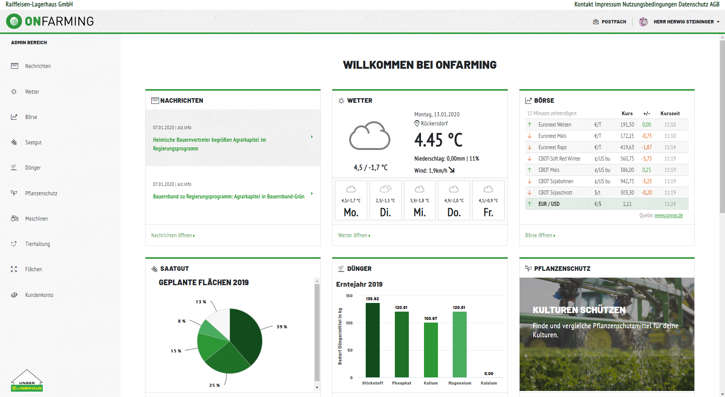
Security in Onfarming
View: Dashboard

Slide 5






Security in Onfarming
Architecture
Zuul
Eureka
Portal
Saatgut
Wetter
Flächen
Database

Slide 6
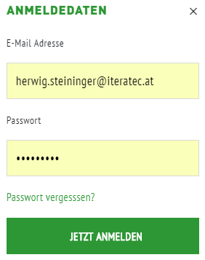


Security in Onfarming
The login process
ReST
ReST
Portal
JWT in
Cookie
JWT
Token via OAuth2

Slide 7

OpenID Connect & JWT
The process
Client
Request Resource
Service
Unauthorized: Redirect
Send Credentials
OpenID Connect Server
JWT Id/Access/Refresh
Request Resource (JWT)
Service
Response

Slide 8
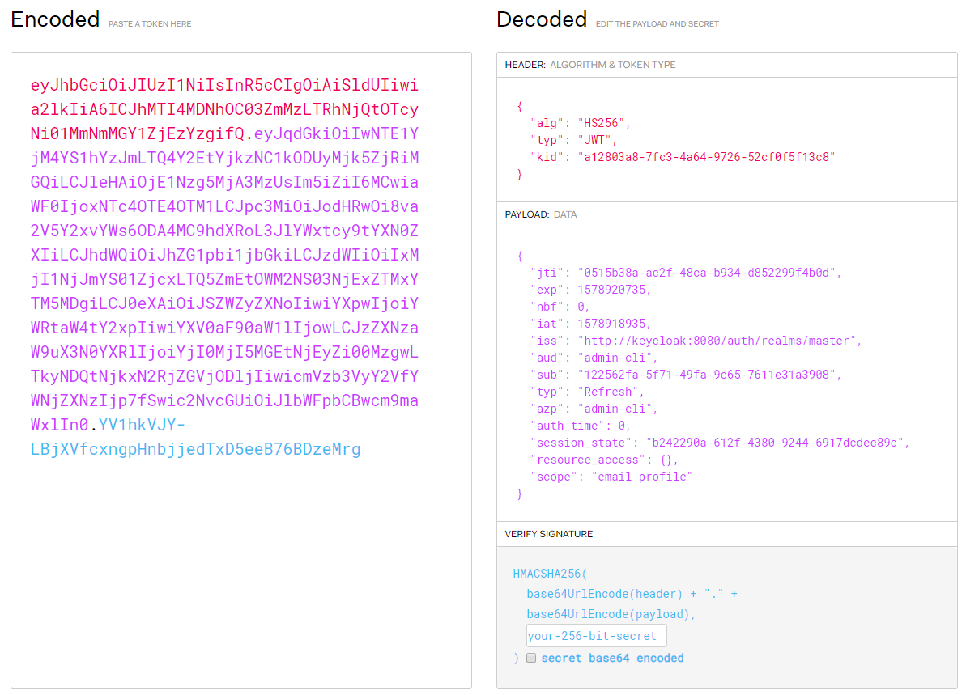
OpenID Connect & JWT
Structure of a JWT

Slide 9


Keycloak
What is it?
Open Source (JBoss/Red Hat)
Identity Management
Access Management
Features
Single Sign On (e.g. OpenID Connect)
Social Login
LDAP Integration
Kerberos
…
Live Demo

Slide 10


Example
General composition
Client
Login
myStarter
Portal
getAccessToken()
Tokens
Tokens
Request
myStarter
Service
Response
Handle Refresh Token

Slide 11
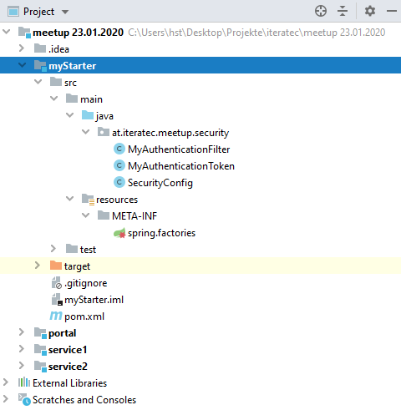
Example
My Spring Boot Security Starter
Live Demo

Slide 12
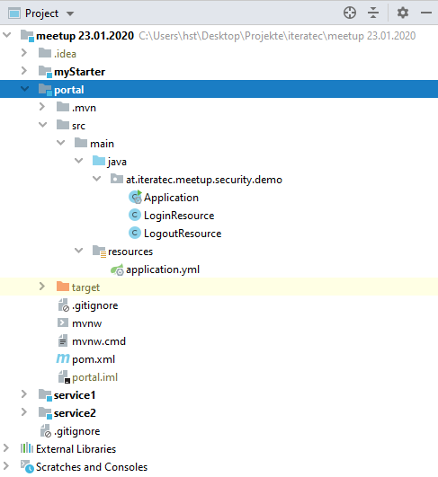
Example
The Portal
Live Demo

Slide 13
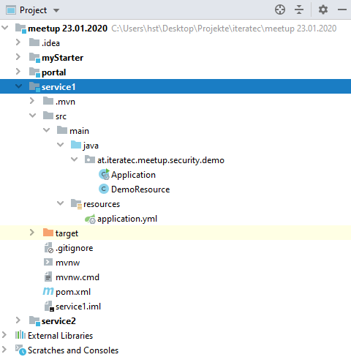
Example
Service #1
Live Demo

Slide 14
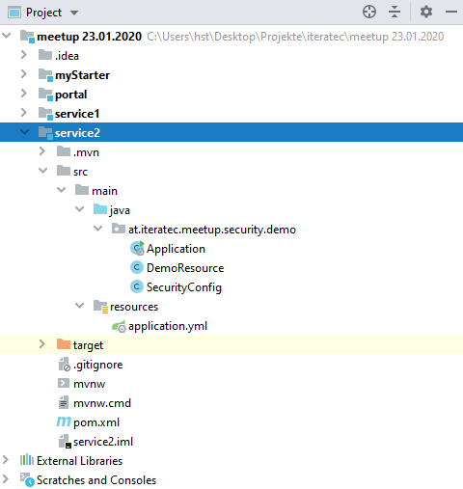
Example with full Keycloak integration
Service #2
Live Demo

Slide 15
Share your experience with Security in Microservices with us…

Slide 16
Thanks for your attention! ☺

